Slide 1
Chapter 3- Internet Protocol Version 4 (IPv4)

Slide 2
Introduction
IP is the transmission mechanism used by TCP/IP protocols at the network layer.
IP is an unreliable and connectionless datagram protocol- best effort delivery service.
Each datagram is handled independently and each datagram can follow a different route to the destination. this implies that datagram send by the same source to the same destination could arrive out of order.
Some could be lost or corrupted during transmission.
IP relies on higher level protocol to take care of all these problems.

Slide 3
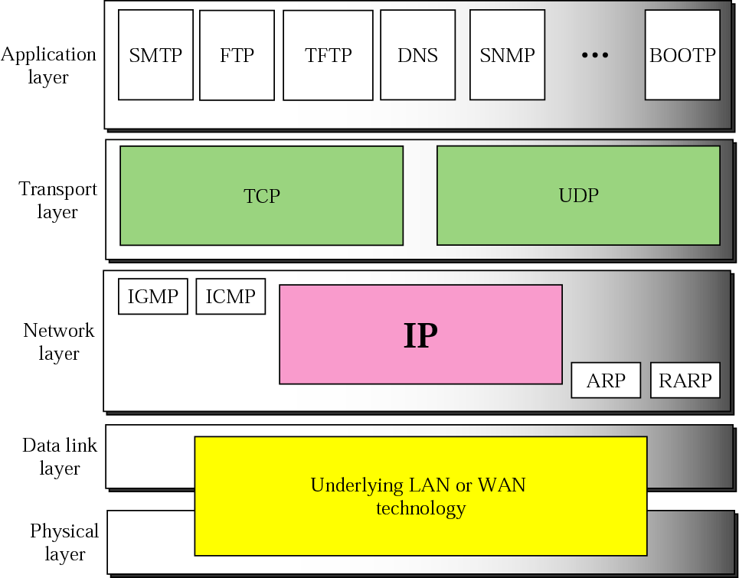
Position of IP in TCP/IP protocol suite

Slide 4
Datagrams
Packets in the network layer are called datagram.
It is a variable length packet consisting of two parts:-
Header
Data
Header:
20 to 60 bytes in length
contains information essential to routing and delivery.
In TCP/IP it is customary to show header in 4 byte section.

Slide 5
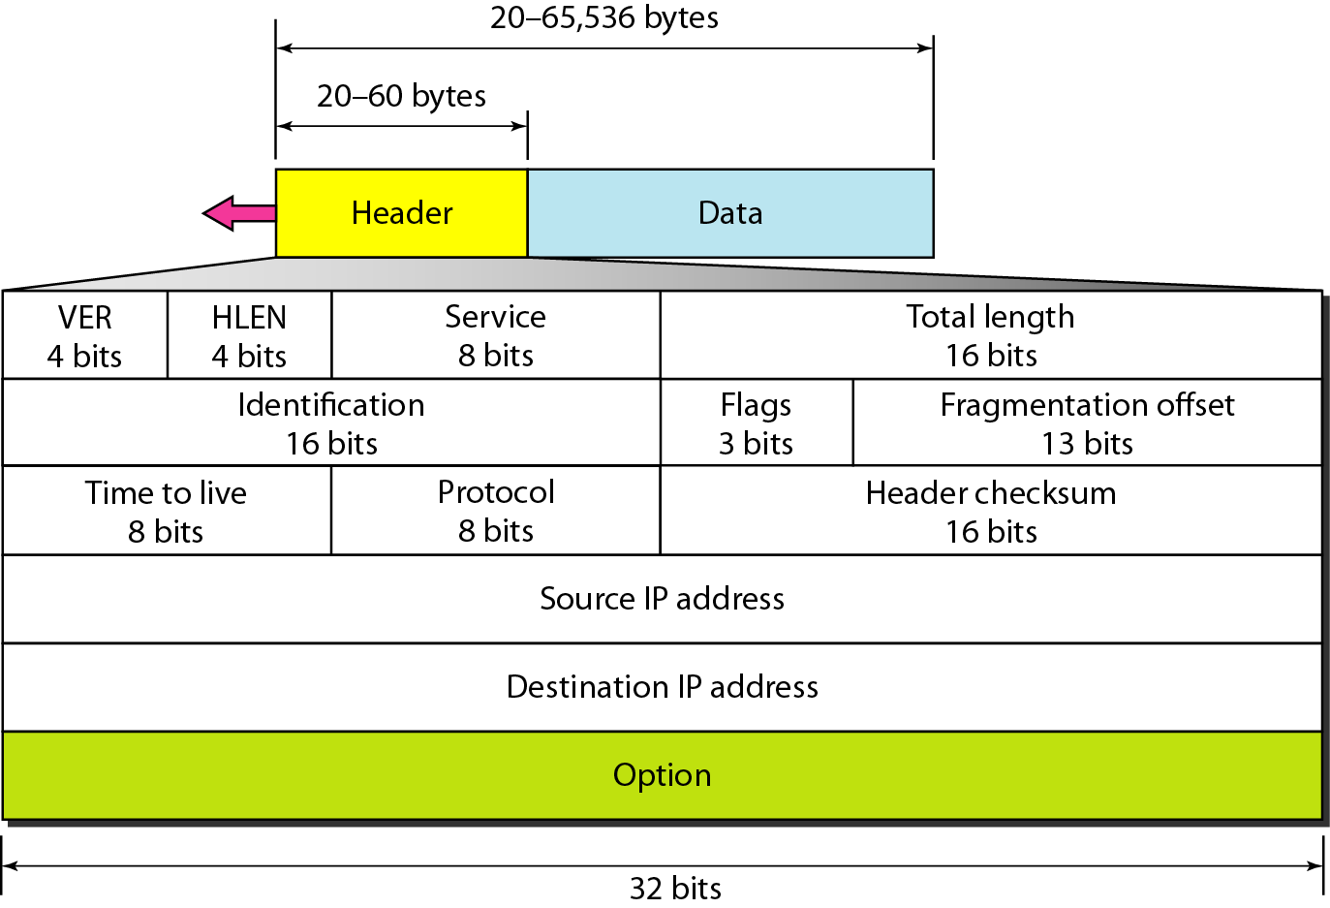
IPv4 datagram format

Slide 6
IPv4 datagram header format
Version(VER):-
4 bit field defines the version [Version 4] of IP software running
If machine is using some other version of IP, the datagram is discarded rather that interpreted incorrectly.
Header Length(HLEN):-
4 bit field defines the total length of the datagram header in 4 byte words.
The length of the header is variable (between 20 and 60 bytes)
When there are no options:-
HLEN is 20 bytes and the value of the field is 5 (5*4=20)
When the options field is at maximum size:
HLEN is 60 bytes value of field is 15 (15*4=60)

Slide 7
Service Type
In original design it can be called as ‘Type of Service (TOS)’
It define how the datagram should be handled.
Part of the field was used to define the precedence of the datagram and rest of the field define type of service (low delay, high throuput and so on)
IETF (Internet engineering task Force) has changed the interpretation of this 8 bit field.
This field now defines a set of Differentiated Services.
The new interpretation is shown in next figure.
In this first 6 bits make up the codepoint subfield and last 2 bits are not used.

Slide 8
Service Type
The codepoint subfield can be used in 2 different ways.
1. When the 3 rightmost bits are 0s, the 3 left most bits are interpreted as the precedence bits in the service type interpretation.
The precedence defines the 8 level priority datagram (0 to 7) in issue such as congestion.
If a router is congested and needs to discard some datagram, those datagram with the lowest precedence are discarded first.
2. When the 3 rightmost bits are not all 0s, the 6 bits define 56(64-8) services based on the priority assignment by the internet or local authorities according to table (next).
The first category contains 24 services types, the second and third each contain 16.
The 1st category is assigned by internet authorities (IETF)
The 2nd category can be used by local authorities (organizations)
The 3rd category is temporary, can be used for experimental purpose.

Slide 9
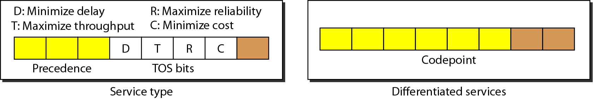
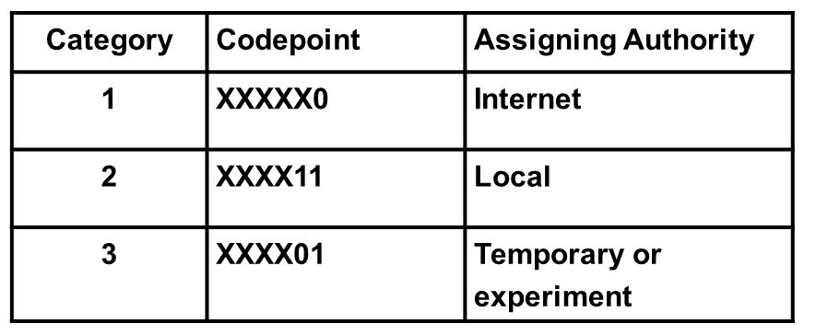
Service Type and value for codepoints
TOS bits
Values for Codepoints

Slide 10
Total Length
This is a 16 bit field that defines the total length (header plus data) of the IP datagram.
Length of Data= total length – header length
Header length can be found by multiplying the value in HLEN field by 4.
Since the field length is 16 bits, the total length of the IP datagram is limited to 65,535 (2¹⁶ -1) bytes of which 20 to 60 bytes are the header and rest is data from upper layer.
The total length field defines the total length of the datagram including the header.

Slide 11
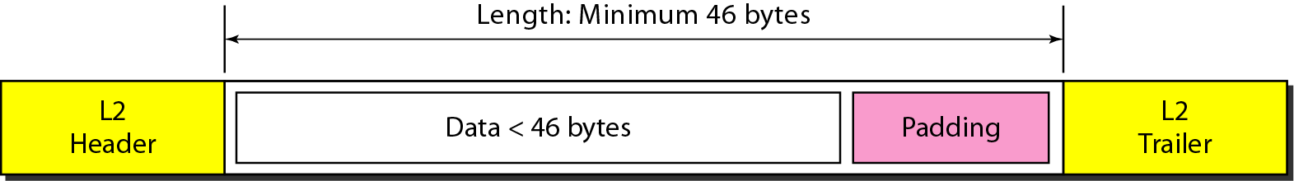
Encapsulation of a small datagram in an Ethernet frame
Why to include extra field that is not needed??
The Ethernet protocol has a minimum and maximum restriction on the size of data that can be encapsulated in a frame (46 to 1500 bytes).
If the size of an IP datagram is <46 bytes, some padding will be added
in such cases, when a machine decapsulates the datagram, it needs to check the total length field to determine how much is really data and how much is the padding.

Slide 12
Remaining fields in IP header Format
Identification : used in fragmentation
Flags: used in fragmentation
Time to Live:
A datagram has a limited lifetime in its travel through an internet.
It is designed to hold a timestamp which was decremented by each visited router.
The datagram was discarded when the value =0
Use of ‘Time to Live’
This field is needed because routing tables in the internet can become corrupted.
This field intentionally limit the journey of the packet.

Slide 13
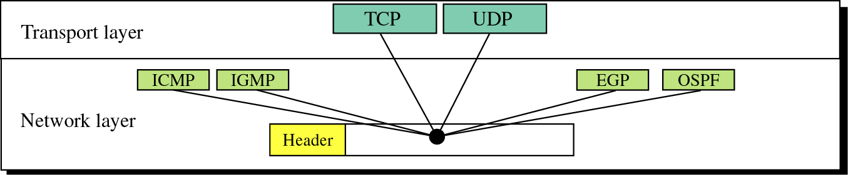
Remaining fields in IP header Format
Protocol:
This 8 bit field defines the higher level protocols that uses the services of the IP layer.
IP protocol multiplex and demultiplex data from different higher level protocols, the value of this field helps in demultiplexing process when the datagram arrives at its final destination.
Value | Protocol | Value | Protocol
1 | ICMP | 17 | UDP
2 | IGMP | 89 | OSPF
16 | TCP
EGP: Exterior Gateway Protocol
OSPF: Open shortest Path First

Slide 14
Remaining fields in IP header Format
Checksum :
Source Address:
32 bit field defines the IP address of the source.
this field must remain unchanged during the time the IP datagram travels from the source host to the destination host.
Destination Address:
32 bit field defines the IP address of the destination.
this field must remain unchanged during the time the IP datagram travels from the source host to the destination host.

Slide 15
Example 1
An IPv4 packet has arrived with the first 8 bits as shown:
01000010
The receiver discards the packet. Why?

Slide 16
Solution
There is an error in this packet. The 4 leftmost bits (0100) show the version, which is correct. The next 4 bits (0010) show an invalid header length (2 × 4 = 8). The minimum number of bytes in the header must be 20. The packet has been corrupted in transmission.

Slide 17
Example 2
In an IPv4 packet, the value of HLEN is 1000 in binary. How many bytes of options are being carried by this packet?

Slide 18
Solution
The HLEN value is 8, which means the total number of bytes in the header is 8 × 4, or 32 bytes. The first 20 bytes are the base header, the next 12 bytes are the options.

Slide 19
Example 3
In an IPv4 packet, the value of HLEN is 5, and the value of the total length field is 0x0028. How many bytes of data are being carried by this packet?

Slide 20
Solution
The HLEN value is 5, which means the total number of bytes in the header is 5 × 4 = 20 bytes (no options).
The total length is 40 bytes, which means the packet is carrying 20 bytes of data (40 − 20).

Slide 21
Example 4
An IPv4 packet has arrived with the first few hexadecimal digits as shown.
0x45000028000100000102 . . .
How many hops can this packet travel before being dropped? The data belong to what upper-layer protocol?

Slide 22
Solution
To find the time-to-live field, we skip 8 bytes(16 hexadecimal digits).
The time-to-live field is the ninth byte, which is 01. This means the packet can travel only one hop.
The protocol field is the next byte (02), which means that the upper-layer protocol is IGMP.

Slide 23
Classful Addressing

Slide 24
IPv4 Addresses
IP Address: identifier used in IP layer to identify each device connected to the internet
It is a 32 bit long address ,unique and universal.
IPv4 addresses has address space.
Address space- is the total number of addresses used by the protocol.
If a protocol uses N bits to define an address, the address space is 2^{N} because each bit can have two different values (0 and 1) and N bits can have 2^{N} values.
The address space of IPv4 is 2³² or 4,294,967,296.

Slide 25
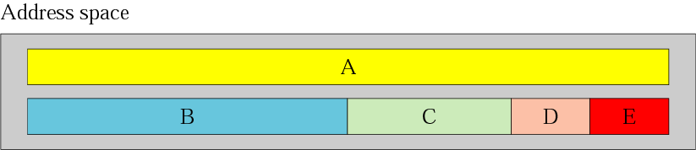
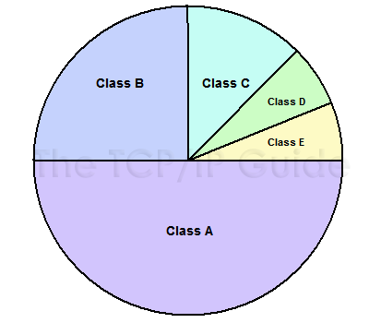
Classful Addrssing
IP address space is divided into five classes: A, B, C,D and E
Class A: 2 ³¹ = 2,147,483,648 addresses, 50%
Class B: 2 ³⁰ = 1,073,741,824 addresses, 25%
Class C: 2 ²⁹ = 536,870,912 addresses, 12.5%
Class D: 2 ²⁸ = 268,435,456 addresses, 6.25%
Class E: 2 ²⁸ = 268,435,456 addresses, 6.25%

Slide 26
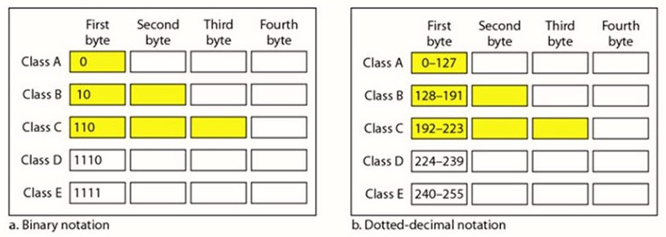
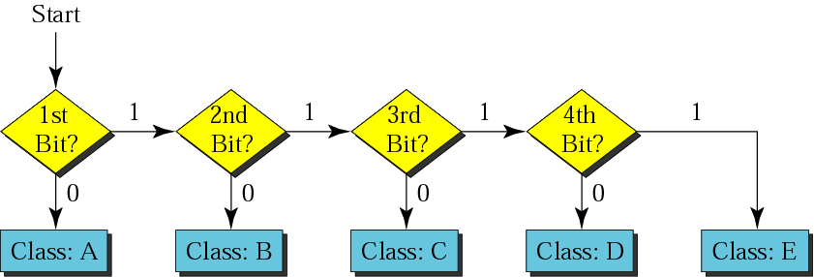
Recognizing classes

Slide 27
Example
Find the class of each address:
a. 00000001 00001011 00001011 11101111
b. 11000001 10000011 00011011 11111111
c. 10100111 11011011 10001011 01101111
d. 11110011 10011011 11111011 00001111

Slide 28
Solution a. The first bit is 0. This is a class A address. b. The first 2 bits are 1; the third bit is 0. This is a class C address. c. The first bit is 0; the second bit is 1. This is a class B address. d. The first 4 bits are 1s. This is a class E address..

Slide 29
Example
Find the class of each address:
a. 227.12.14.87
b.193.14.56.22
c.14.23.120.8
d. 252.5.15.111
e.134.11.78.56

Slide 30
Solution a. The first byte is 227 (between 224 and 239); the class is D.
b. The first byte is 193 (between 192 and 223); the class is C.
c. The first byte is 14 (between 0 and 127); the class is A.
d. The first byte is 252 (between 240 and 255); the class is E.
e. The first byte is 134 (between 128 and 191); the class is B.

Slide 31
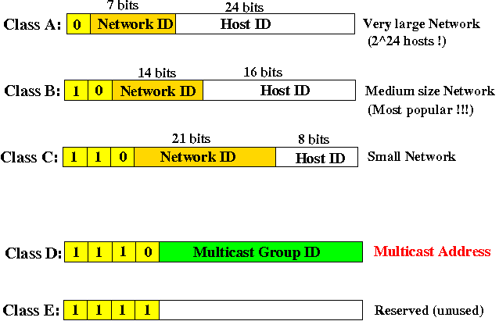
Netid and Hostid

Slide 32
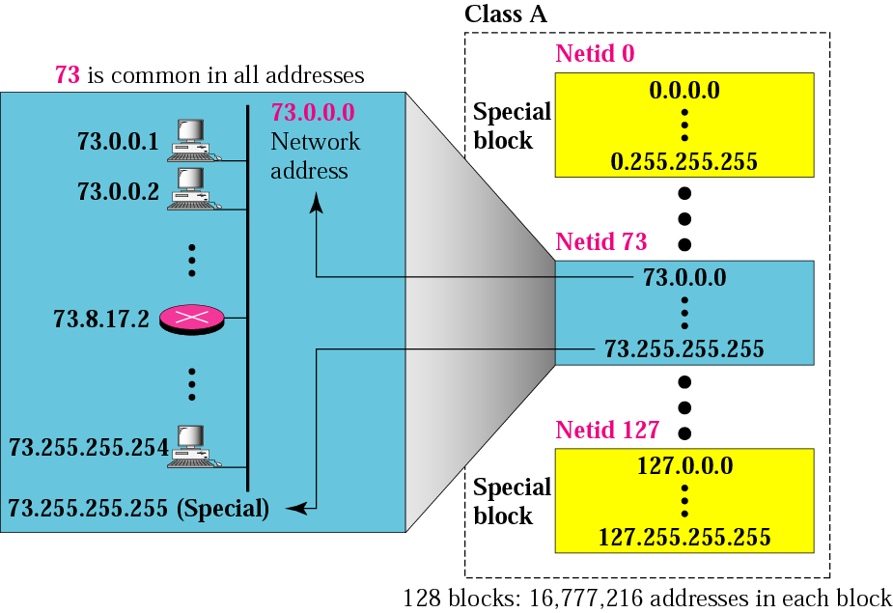
Blocks in class A
1 byte=Netid with leftmost bit 0 , Number of blocks=2⁷ = 128 , each block=16,777,216 addresses Many addresses are wasted

Slide 33
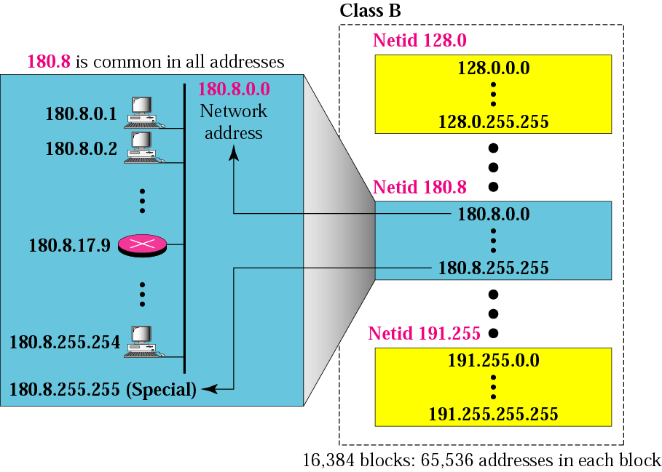
Blocks in class B
2 byte = Netid with leftmosts bit 10 , Number of blocks=2¹⁴ = 16,384 , each block=65,536 addresses Many addresses are wasted

Slide 34

Blocks in class C
3 byte = Netid with leftmost bits 110 , Number of blocks=2²¹ = 2,097,152 , each block=256 addresses . Not so organizations are so small to have a class C block.

Slide 35
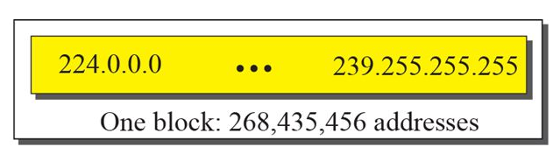
The single block in class D
Designed for multicasting
Each address in this class is used to define one group of hosts on the internet.
When a group is assigned an address in this class, every host that is a member of this group will have a multicast address in addition to its normal (unicast) address.

Slide 36
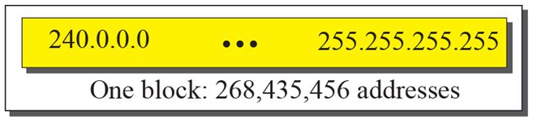
The single block in class E
The only block of class E addresses was reserved for future purposes.

Slide 37
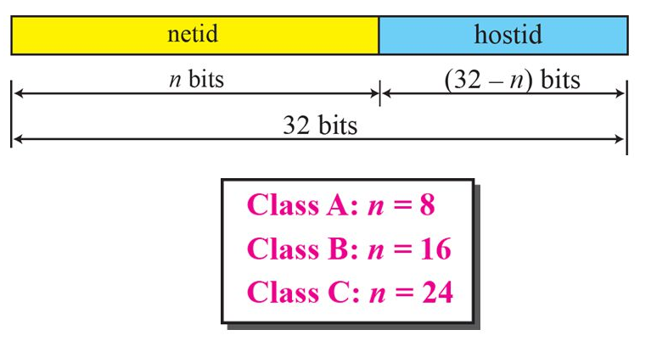
Two Level Addressing
All addresses in a network belonged to a single block
Each address in classful addressing contains two parts: netid and hostid
The netid defines the network and hostid defines particular host connected to that network.

Slide 38
Example:

Slide 39
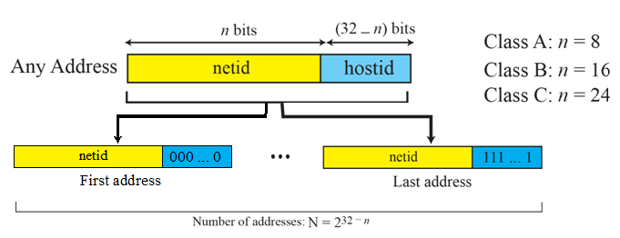
Information extraction in classful addressing
The number of addresses in the block, N , can be found using N = 2^{32-n}
To find the first address, we keep the n leftmost bits and set the (32-n) rightmost bits all to 0s.
To find the last address, we keep the n leftmost bits and set the (32-n) rightmost bits all to 1s.

Slide 40
Example
An address in a block is given as 73.22.17.25.Find the number of addresses in the block, the first address, and the last address.
Solution
As 73 is in between 0 & 127, its Class=A , n=8

Slide 41
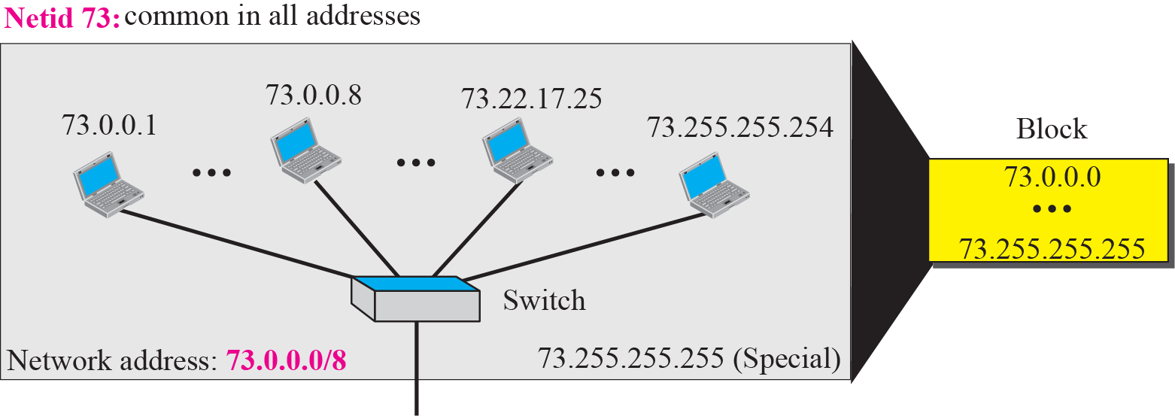
Solution
The number of addresses in the block, N , can be found using N = 2^{32-n} = 2²⁴ =16,777,216
To find the first address, we keep the n leftmost bits and set the (32-n = 24) rightmost bits all to 0s. The first address (called as network address) is 73.0.0.0/8 in which 8 is the value of n and not assigned to any host.
To find the last address, we keep the n leftmost bits as it is and set the (32-n=24) rightmost bits all to 1s. The last address is 73.255.255.255. the last address is normally used for a special purpose.

Slide 42
Example
An address in a block is given as 180.8.17.9. Find the number of addresses in the block, the first address, and the last address.
Solution
As 180 is in between 128 & 191, its Class=B, n=16

Slide 43
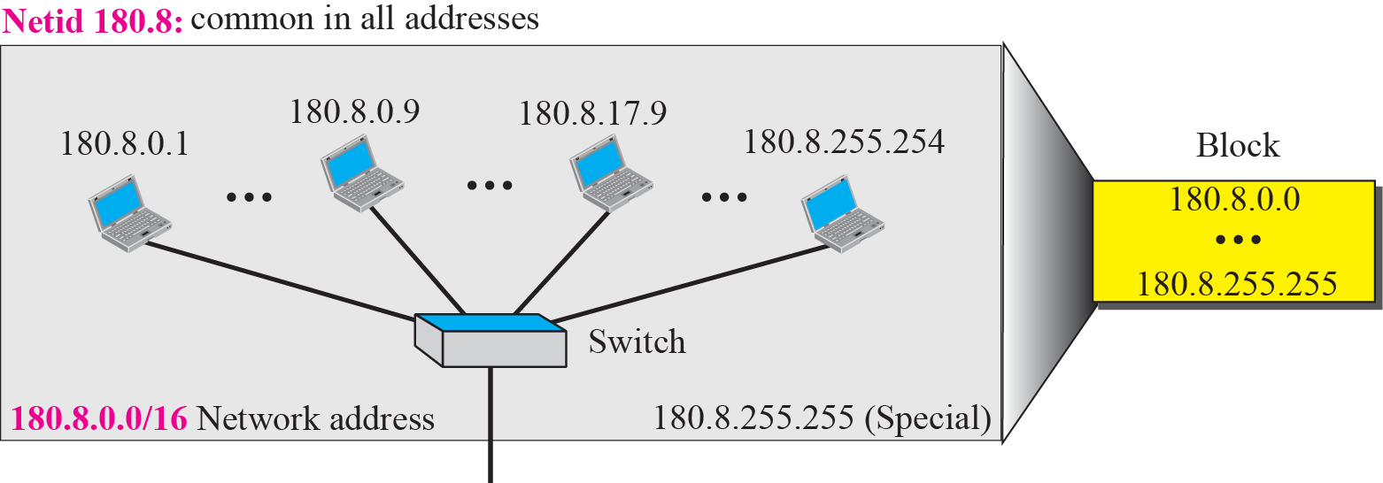
Solution
The number of addresses in the block, N , can be found using N = 2^{32-n} = 2¹⁶ =65,536
To find the first address, we keep the leftmost 16 bits and set the (32-n=16) rightmost 16 bits all to 0s. The first address(network address) is 18.8.0.0/16
To find the last address, we keep the leftmost 16 bits and rightmost 16 bits to 1s. The last address is 18.8.255.255

Slide 44
Example
An address in a block is given as 200.11.8.45. Find the number of addresses in the block, the first address, and the last address.
Solution
As 200 is in between 192 & 223, its Class=C, n=24

Slide 45
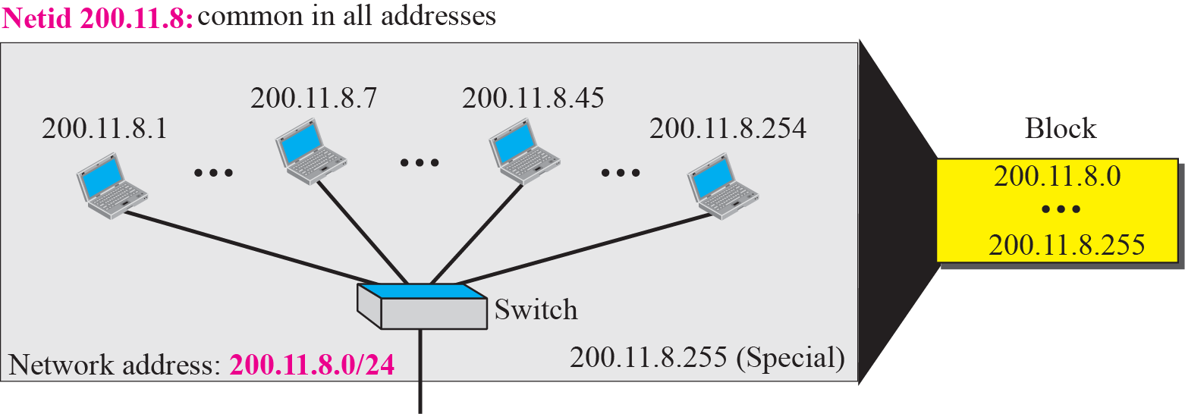
Solution
The number of addresses in the block, N , can be found using N = 2^{32-n} = 2⁸ =256
To find the first address, we keep the leftmost 24 bits and set the (32-n=16) rightmost 8 bits all to 0s. The first address(network address) is 200.11.8.o/24
To find the last address, we keep the leftmost 24 bits and all to 1s. The last address is 200.11.8.255

Slide 46
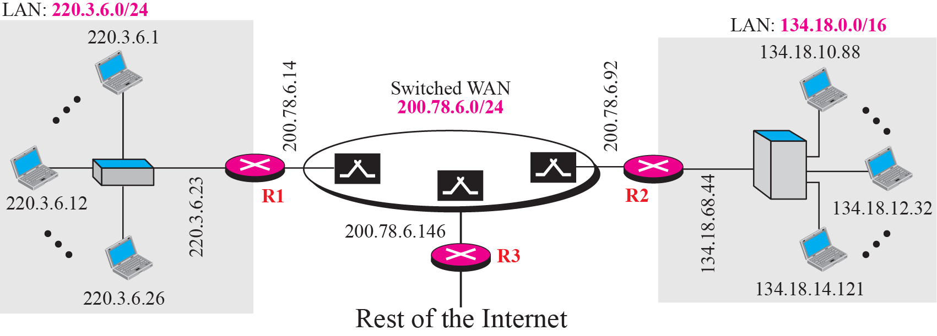
Sample Internet
Example: A hypothetical part of an internet with three network.
A LAN with the network address 220.3.6.0 (class C)
A LAN with the internet address 134.18.0.0 (class B)
A switched WAN (class C) such as Frame Relay or ATM, can be connected to many routers. (here 3 routers- 1 for WAN to left LAN, 2nd WAN to right LAN and 3rd WAN to rest of the internet.)

Slide 47
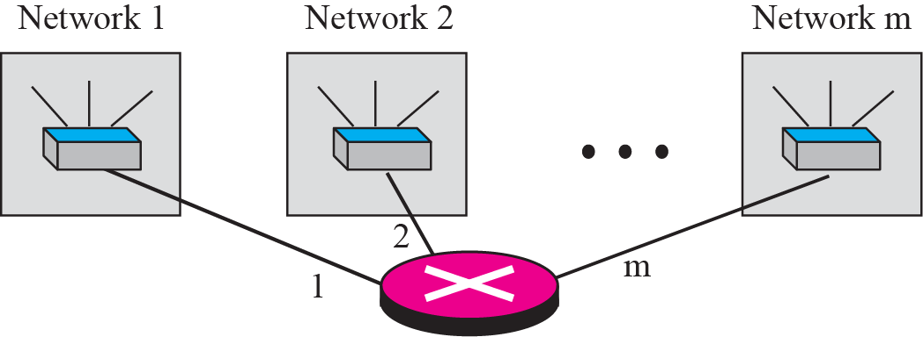
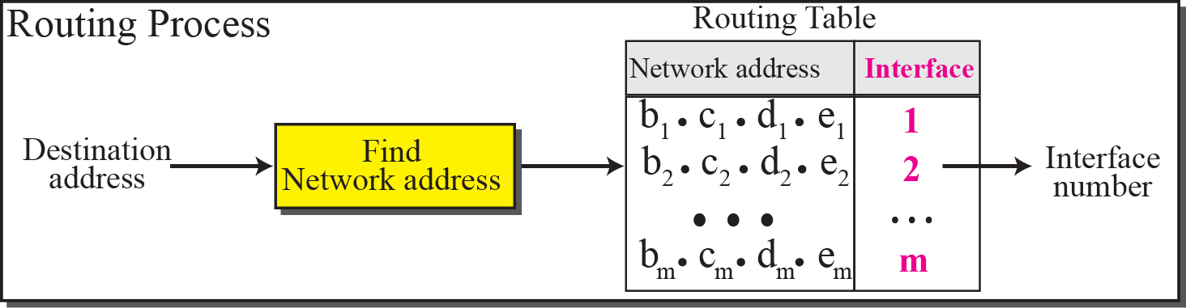
Network Address
The network address is the identifier of a network.
It is the first address, used in routing a packet to its destination address.

Slide 48
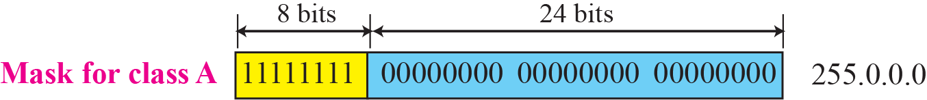
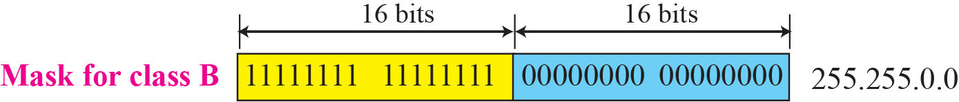
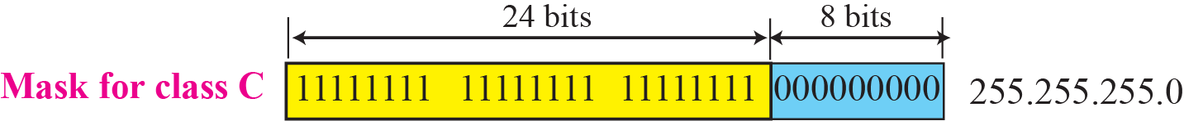
Network Mask
A network mask or default mask in classful addressing 32 bit number with n leftmost bits all set to 1s and (32-n) rightmost bits all set to 0s.
Since n is different for each class in classful addressing, we have 3 default masks in classful addressing as shown in above diagram.

Slide 49
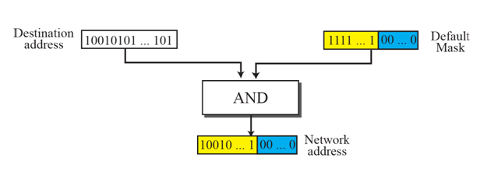
Finding a network address using the default mask
To extract the network address from destination address of a packet, a router uses the AND operation.

Slide 50
Example
A router receives a packet with the destination address 201.24.67.32. Show how the router finds the network address of the packet.
Solution
Since the class of the address is C, we assume that the router applies the default mask for class B, 255.255.255.0 to find the network address.

Slide 51
Subnetting
Splitting a block to smaller blocks is subnetting
In Subnetting, a network is divided into several smaller subnetworks (subnets) with each subnetworking having its own subnetwork address.
Three level Addressing:
Three-level addressing can be found in the telephone system
626 is the area code, 358 is the exchange, and 1301 is the subscriber connection.

Slide 52
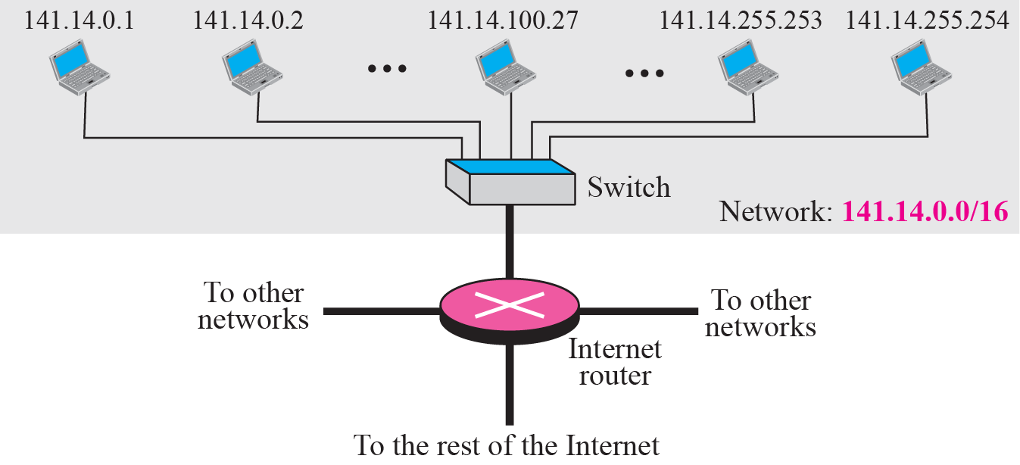
Example
Figure (next) shows class B addresses before subnetting.
one network with almost 2¹⁶ hosts. The whole network is connected, through one single connection, to one of the routers in the Internet.
/16 to show the length of the netid (class B).

Slide 53
same network after subnetting
The whole network is still connected to the Internet through the same router. However, the network has used a private router to divide the network into four subnetworks. The rest of the Internet still sees only one network; internally the network is made of four subnetworks. Each subnetwork can now have almost 2¹⁴ hosts. The network can belong to a university campus with four different schools (buildings). After subnetting, each school has its own subnetworks, but still the whole campus is one network for the rest of the Internet. Note that /16 and /18 show the length of the netid and subnetids.

Slide 54
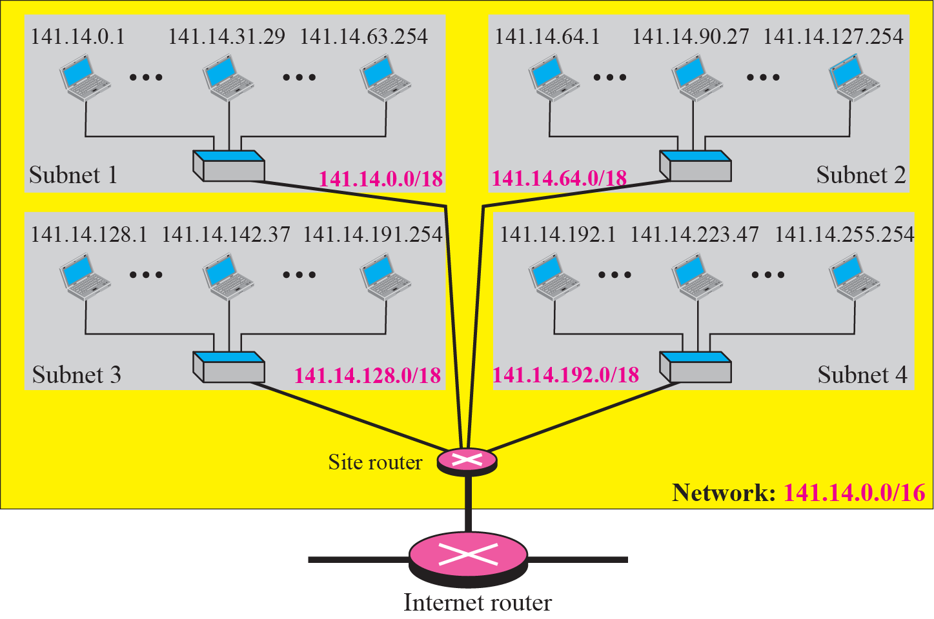

Slide 56
Table 19.1 Number of blocks and block size in classful IPv4 addressing

Slide 57
Table 19.2 Default masks for classful addressing

Slide 58

Note
The first address in a block is normally not assigned to any device; it is used as the network address that represents the organization to the rest of the world.

Slide 59
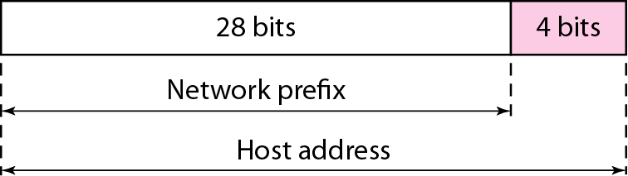
Figure 19.6 A frame in a character-oriented protocol

Slide 60
Note
Each address in the block can be considered as a two-level hierarchical structure: the leftmost n bits (prefix) define the network;
the rightmost 32 − n bits define the host.

Slide 61
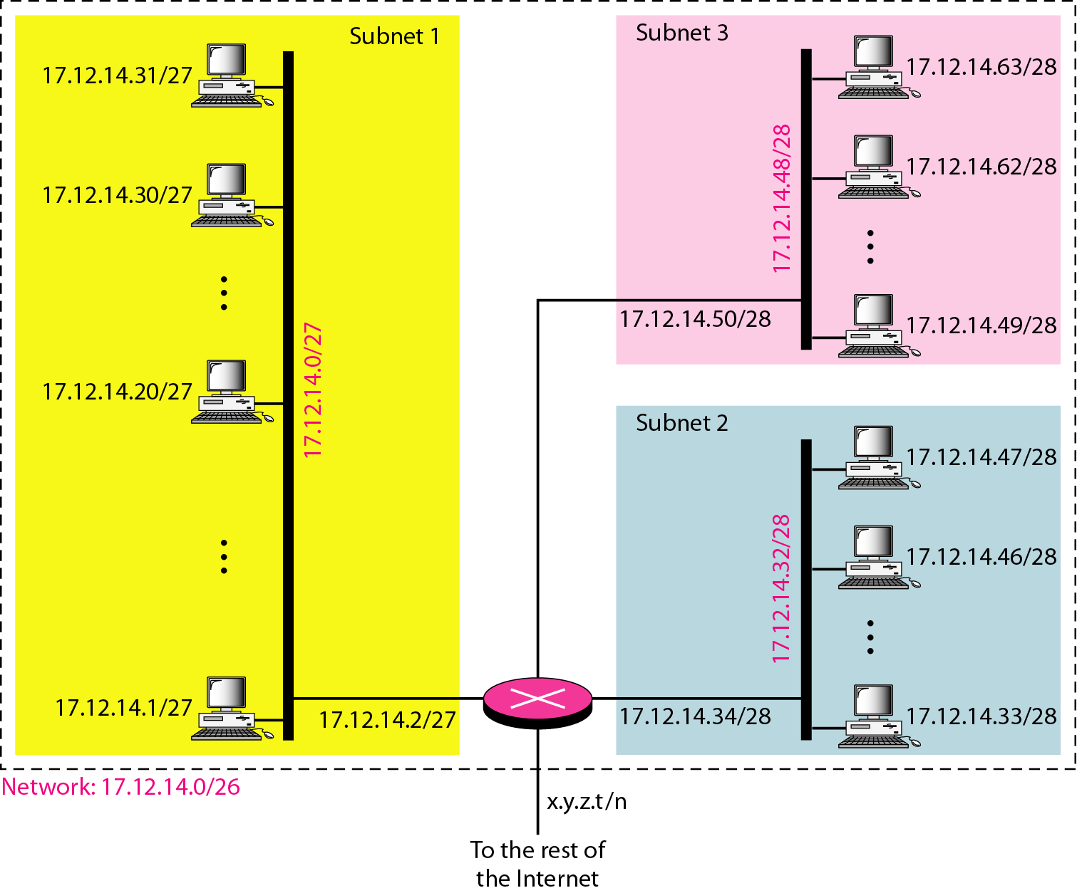
Figure 19.7 Configuration and addresses in a subnetted network

Slide 62
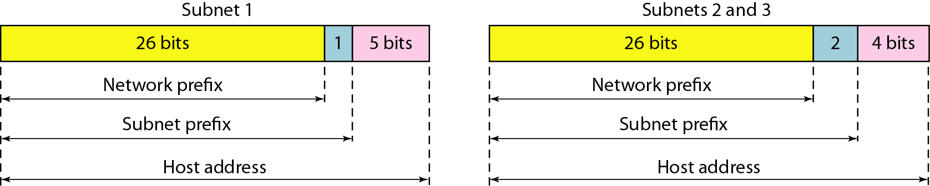
Figure 19.8 Three-level hierarchy in an IPv4 address

Slide 63
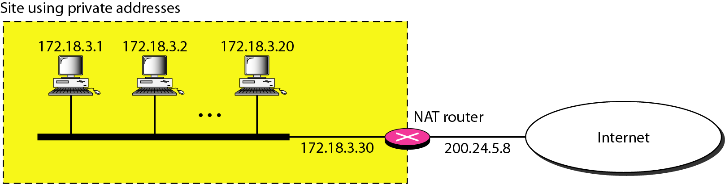
Figure 19.10 A NAT implementation

Slide 64
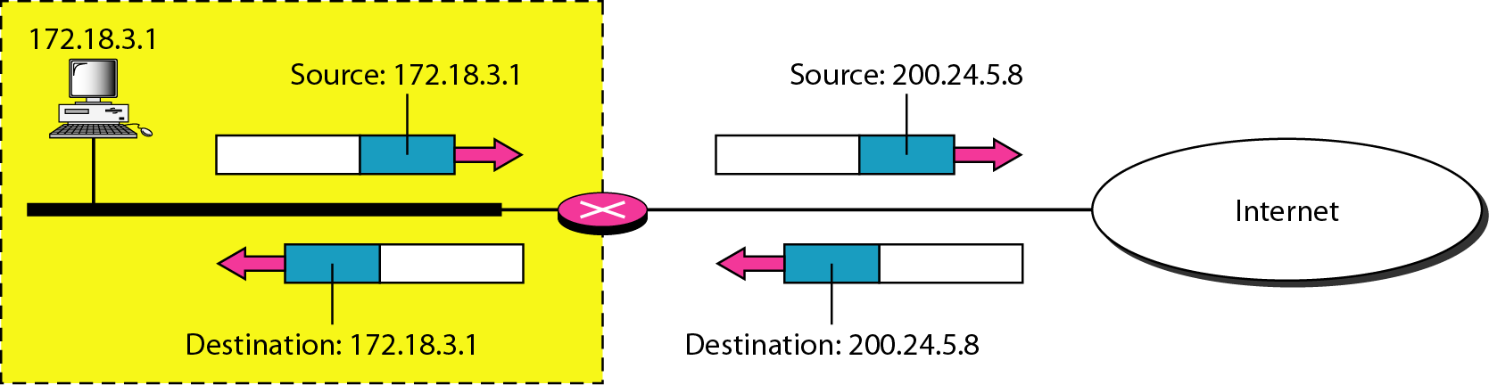
Figure 19.11 Addresses in a NAT

Slide 65
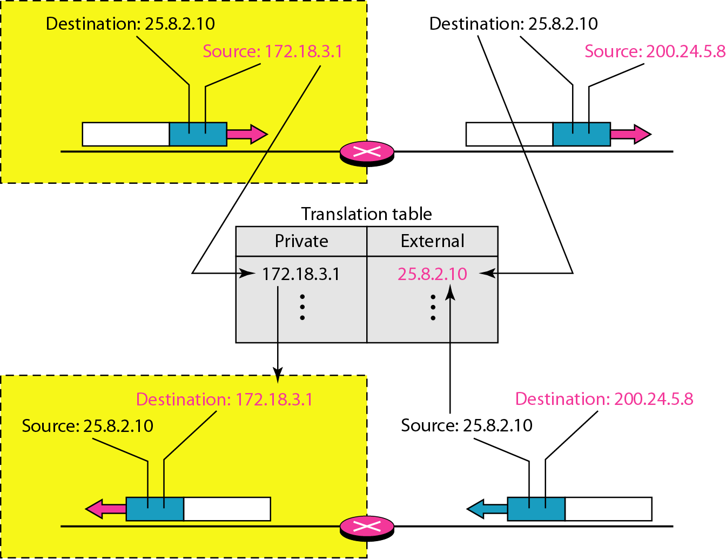
Figure 19.12 NAT address translation

Slide 66
Table 19.4 Five-column translation table

Slide 67
19-2 IPv6 ADDRESSES
Despite all short-term solutions, address depletion is still a long-term problem for the Internet. This and other problems in the IP protocol itself have been the motivation for IPv6.
Topics discussed in this section:
Structure Address Space

Slide 68
Note
An IPv6 address is 128 bits long.

Slide 69
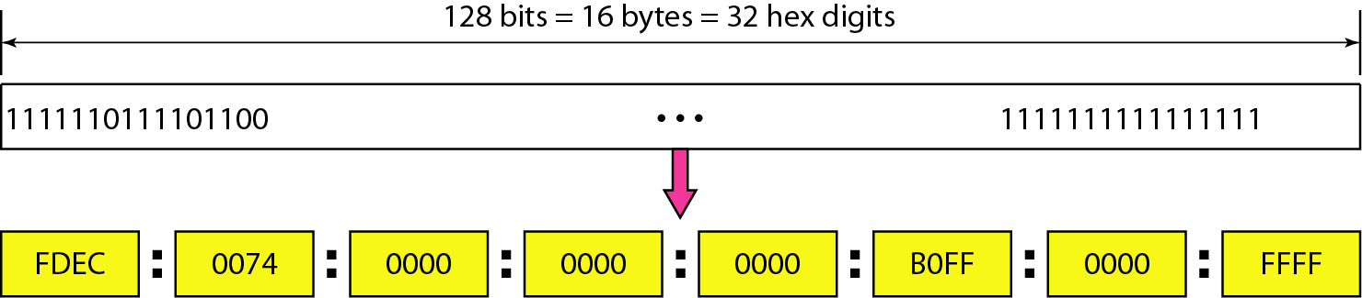
Figure 19.14 IPv6 address in binary and hexadecimal colon notation

Slide 70
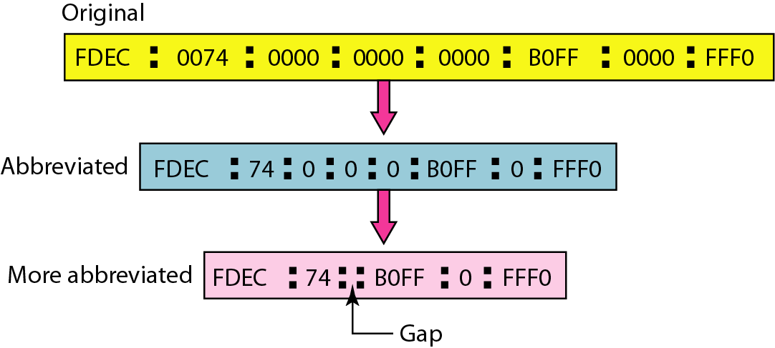
Figure 19.15 Abbreviated IPv6 addresses

Slide 71
Example 19.11
Expand the address 0:15::1:12:1213 to its original.
Solution
We first need to align the left side of the double colon to the left of the original pattern and the right side of the double colon to the right of the original pattern to find how many 0s we need to replace the double colon.
This means that the original address is.

Slide 72
IPv4 Addressing Concepts and Their IPv6 Equivalents
IPv4 Address | IPv6 Address
Address Length – 32 bits | 128 bits
Address Representation - decimal | hexadecimal
Internet address classes | Not applicable in IPv6
Multicast addresses (224.0.0.0/4) | IPv6 multicast addresses (FF00::/8)
Broadcast addresses | Not applicable in IPv6
Unspecified address is 0.0.0.0 | Unspecified address is ::
Loopback address is 127.0.0.1 | Loopback address is ::1
Public IP addresses | Global unicast addresses
Private IP addresses (10.0.0.0/8, 172.16.0.0/12, and 192.168.0.0/16) | Site-local addresses (FEC0::/10)
Autoconfigured addresses (169.254.0.0/16) | Link-local addresses (FE80::/64)

Slide 73
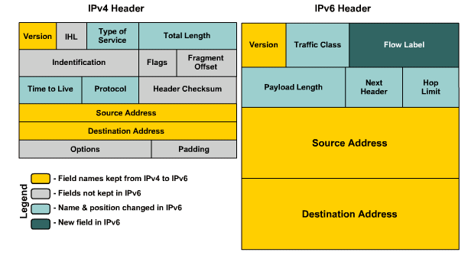
IPv4 vs IPv6 Header

Slide 74
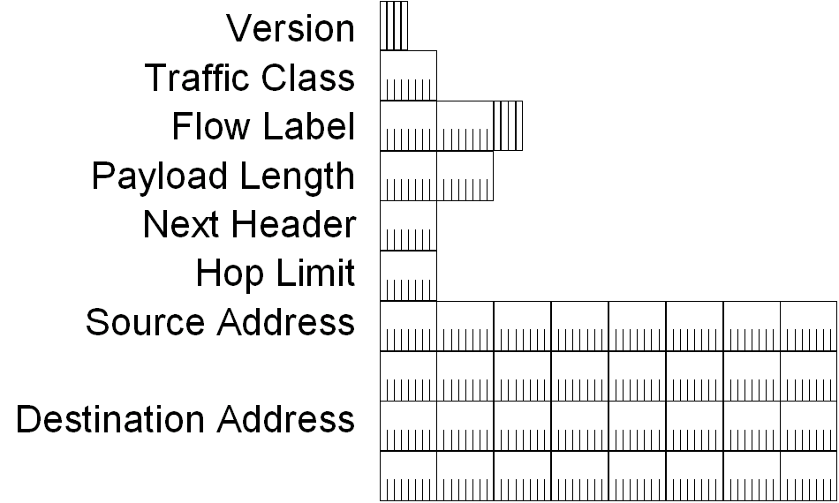
IPv6 Header

Slide 75
IPv6 Header Fields
Based on these rules, RFC 2460 defines the following IPv6 header fields:
Version (4 bits)
4 bits are used to indicate the version of IP and is set to 6
Traffic Class (8 bits)
same function as the Type of Service field in the IPv4 header.
Flow Label (20 bits)
identifies a flow and it is intended to enable the router to identify packets that should be treated in a similar way without the need for deep lookups within those packets.
set by the source and should not be changed by routers along the path to destination.

Slide 76
IPv6 Header Fields
Payload Length (16 bits)
With the header length fixed at 40 bytes, it is enough to indicate the length of the payload to determine the length of the entire packet.
Next Header (8 bits)
Indicates either the first extension header (if present) or the protocol in the upper layer PDU (such as TCP, UDP, or ICMPv6).
Hop Limit (8 bits)
In IPv6, the IPv4 TTL was appropriately renamed Hop Limit because it is a variable that is decremented at each hop, and it does not have a temporal dimension.

Slide 77
IPv6 Header Fields
Source IPv6 Address (128 bits)
Stores the IPv6 address of the originating host.
Destination IPv6 Address (128 bits)
Stores the IPv6 address of the current destination host.

Slide 78
Thank you

